Slide 1
EXCEL FORECASTING

Slide 2
REGRESSION + CLASSIFICATION
PYTHON FOR DATA SCIENCE
DATABASES AND SQL
EXCEL FORECASTING
EXCEL -> DATABASE
MODEL TRAINING

Slide 3
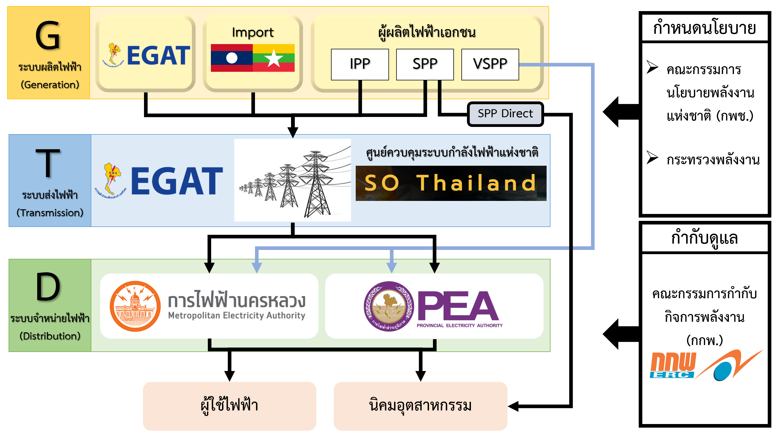

Slide 4
Pattern 1: Holidays

Slide 6
No หยุดชดเชย

Slide 7
Fri Sat Sun

Slide 9
วันขึ้นปีใหม่

Slide 10
วันเด็ก
1 day after วันขึ้นปีใหม่

Slide 11
Pattern 2: Sundays

Slide 15
Pattern 3: Seasons

Slide 18
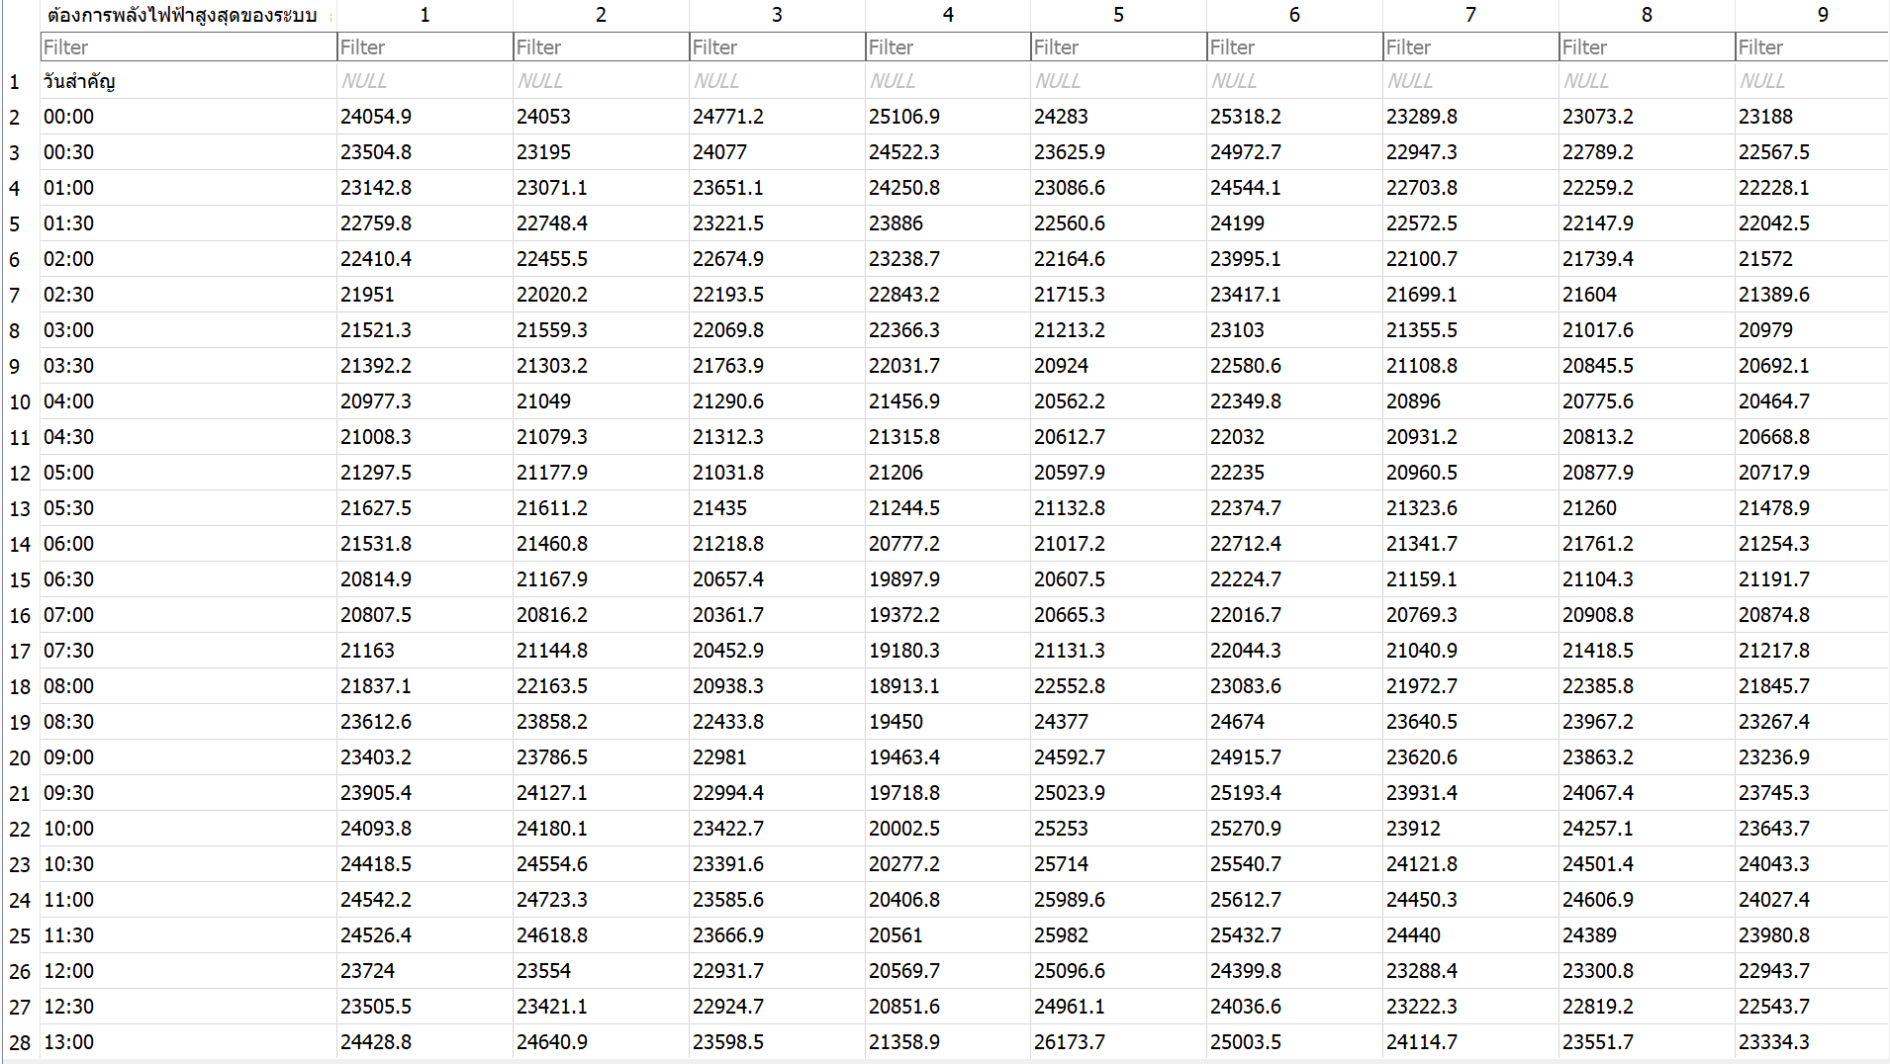
DATABASE

Slide 19
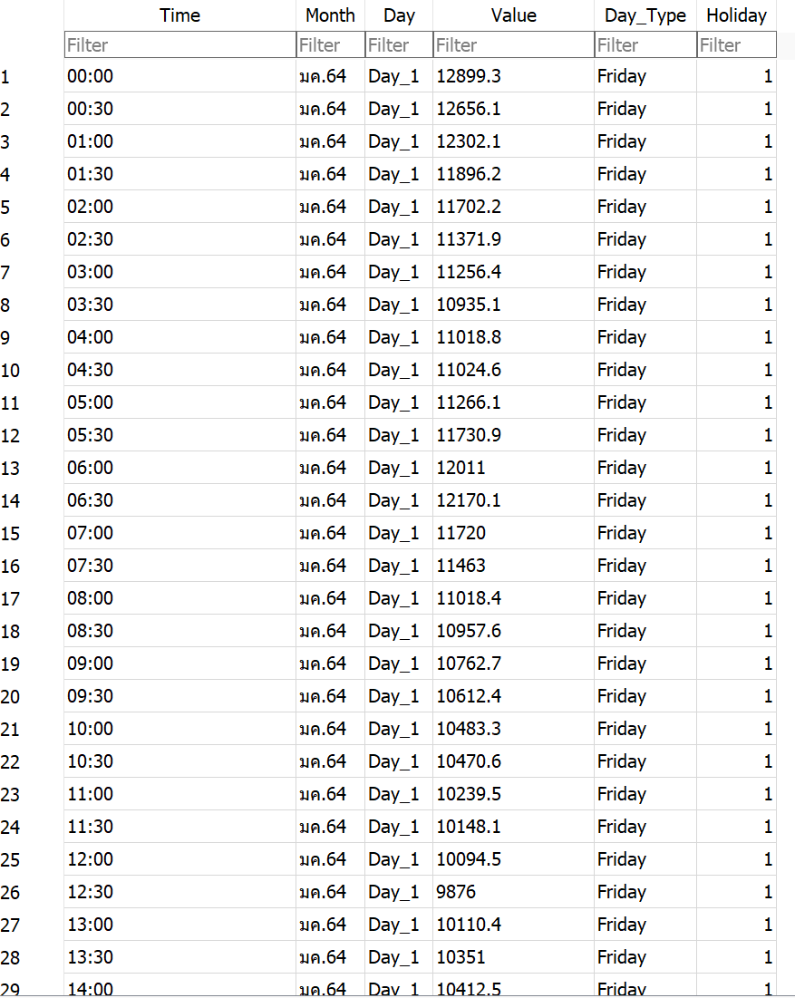

Slide 20
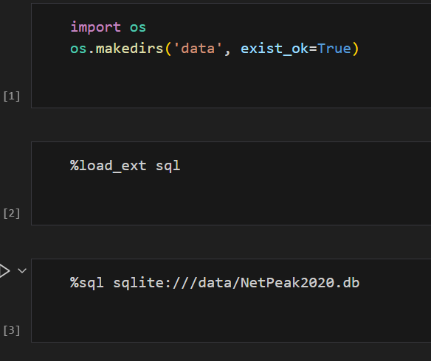
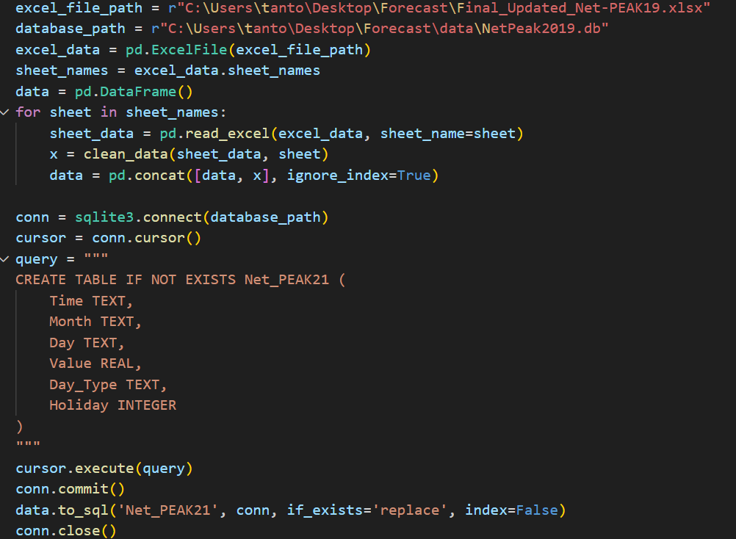
Code

Slide 21
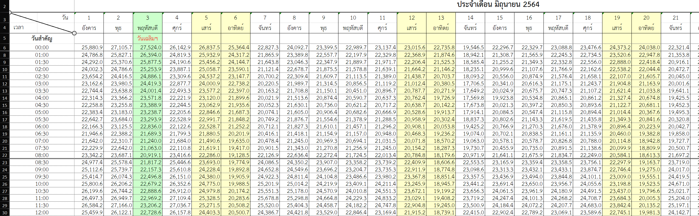
Problems
EMPTY

Slide 22
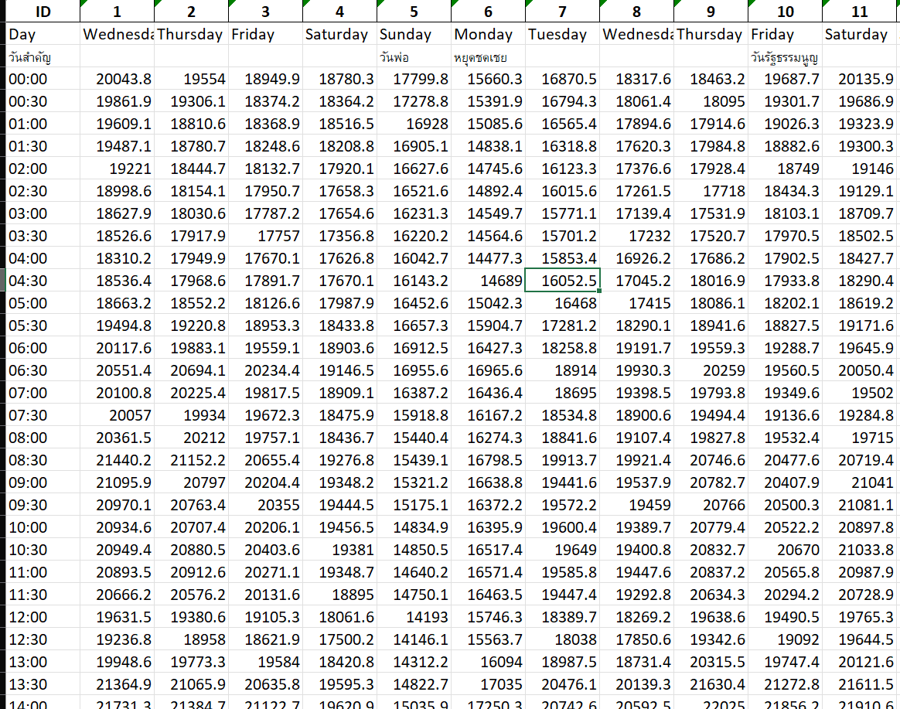

Slide 23
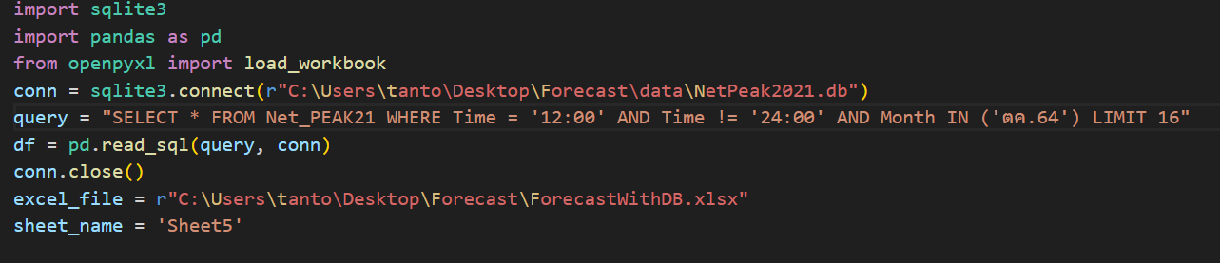
Data Querying

Slide 24
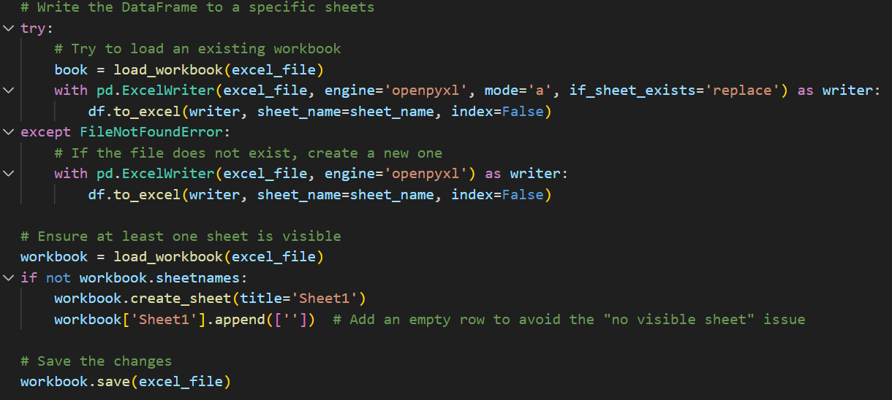
Uploading to Excel

Slide 25
Features

Slide 26
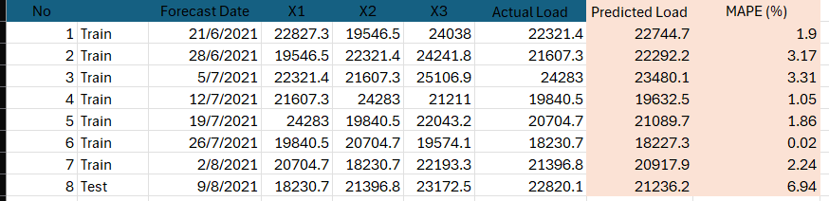
X3 = Previous day load at the same time
X2 = Past 7 days load at the same time
X1 = Past 14 days load at the same time

Slide 27
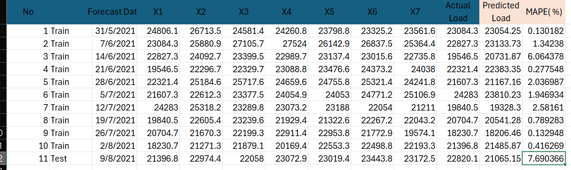
X1-X7 = Previous 7 Days load at the same time

Slide 28
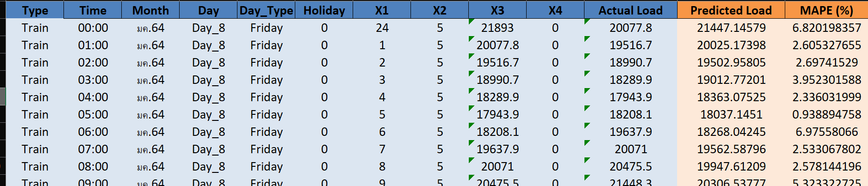
.
.
.
X1 = Hour
X2 = Day of the week
X3 = Previous Hour Load
X4 = Holiday

Slide 29
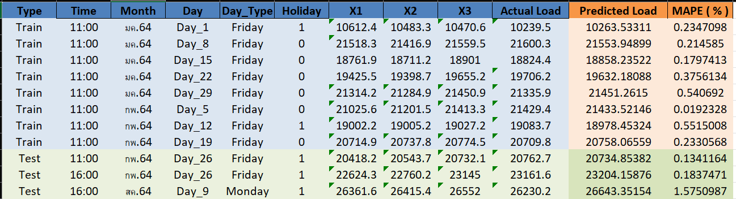
X1 = Load 1.5 hours ago
X2 = Load 1 hour ago
X3 = Load 0.5 hour ago

Slide 30
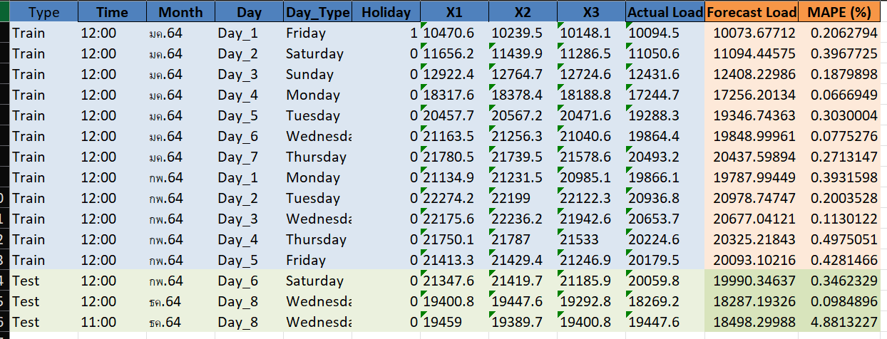
X1 = Load 1.5 hours ago
X2 = Load 1 hour ago
X3 = Load 0.5 hour ago

